Slide 1
Medical Data Analysis for Diabetes Risk Prediction and Health Management
Rui Wang
Raghunath Male
Niranjan Reddy Dumpa

Slide 2
Introduction
CRISP-DM stands for Cross Industry Standard Process for Data Mining. It is a robust and well-established methodology that provides a structured approach to planning and executing a data science project.

Slide 3
The CRISP-DM methodology consists of six main phases:
Business Understanding
Data Understanding
Data Preparation
Modeling
Evaluation
Deployment

Slide 4
CONTENTS
Background
Business Understanding
Data Understanding
Data Preparation
Modeling
Evaluation
Deployment

Slide 5

Background
With the increasing prevalence of diabetes worldwide, how to predict and effectively manage diabetes has become an important issue in the healthcare field.
Diabetes not only reduce the quality of life of patients, but also bring a series of complications such as heart disease, kidney disease, and blindness.
The goal of this project is to use machine learning and data science techniques to build an effective diabetes risk prediction model through the analysis of diabetes-related medical data, to help doctors and patients identify diabetes earlier, monitor the condition, and provide personalized intervention recommendations.

Slide 6
Phase 1: Business Understanding:
In this scenario, the first business problem is to accurately predict whether or not the patients in the dataset have diabetes.
The objective is to build a model that can accurately classify patients based on the given features, which will help in early diagnosis and treatment of diabetes.
The second problem is to find the blood sugar trend based on the patient‘s historical blood sugar measurement records and make predictions about the situation in the next few days.
The objective is to provides a prediction tool based on historical blood sugar data to help users monitor and predict blood sugar trends and prevent potential health risks..

Slide 7
Project Plan
Load and explore the dataset to understand its structure and content.
Perform exploratory data analysis (EDA) to visualize the distribution of features and target variable.
Clean the data by handling missing values, encoding categorical variables, and scaling features.
Select relevant features for modeling.
Apply various models and evaluate their performance.
Optimize the best performing model and validate it.
Summarize the findings and make recommendations.

Slide 8
Phase 2 :Data Understanding
Notes:
In this phase, we’ll load the dataset and perform an initial exploration to understand its structure, content, and quality. We’ll look at the summary statistics, check for missing values, and visualize the distribution of features and the target variable.

Slide 9
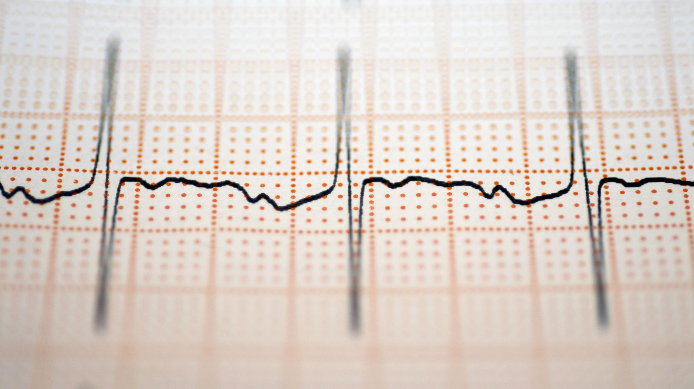
Dataset 1:
Rows: Each row corresponds to a unique patient record.
Columns:
Pregnancies: The number of times the patient has been pregnant (a numeric value).
Glucose: Plasma glucose concentration in an oral glucose tolerance test.
Blood Pressure: The diastolic blood pressure (measured in mm Hg).
Skin Thickness: Triceps skinfold thickness (measured in mm).
Insulin: 2-hour serum insulin levels (measured in mu U/ml).
BMI: Body mass index (calculated as weight in kg divided by height in m²).
Diabetes Pedigree Function: A score indicating the likelihood of diabetes based on family history.
Age: Age of the patient in years.
Outcome: A binary variable where 1 indicates the presence of diabetes and 0 indicates the absence.
Kaggle Dataset:-https://www.kaggle.com/datasets/mathchi/diabetes-data-set

Slide 10
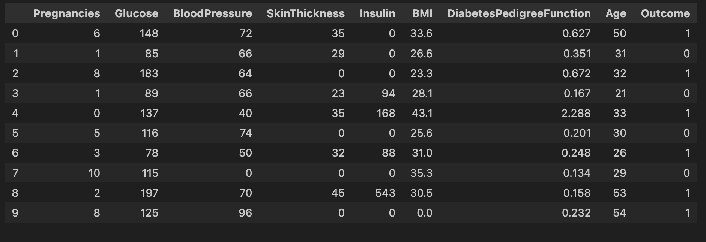
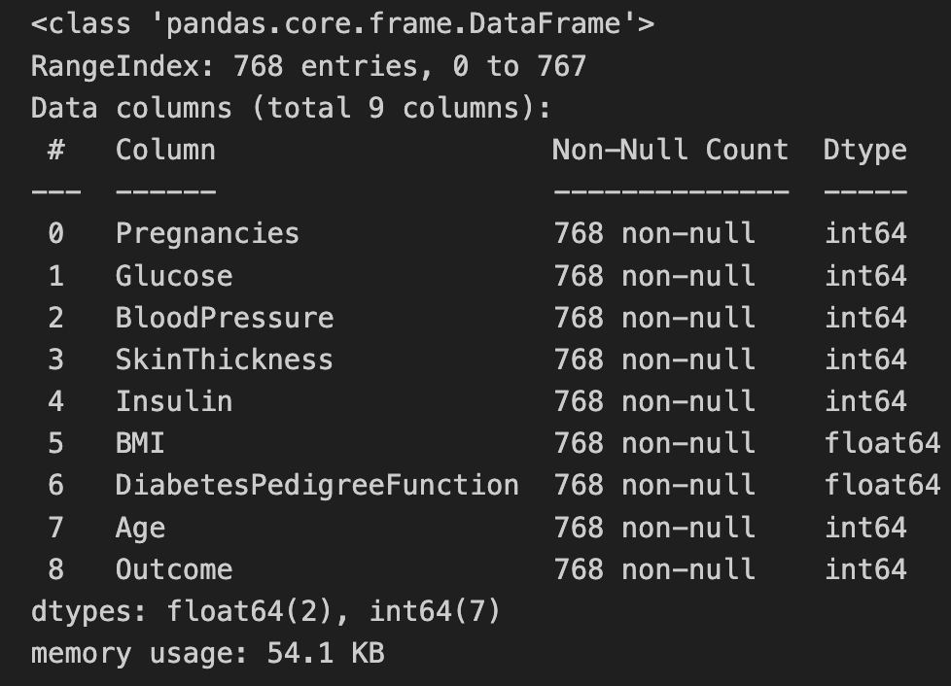
The dataset contains 768 rows (patients) and 9 columns (features including the target variable).
There are no missing values
The target variable “Outcome” is binary
Notes:
The dataset consists of the following columns:...........
Outcome: Class variable (0 or 1) where 1 denotes that the patient has diabetes
Next, let’s explore some summary statistics and check for any missing or unusual values in the dataset.

Slide 11
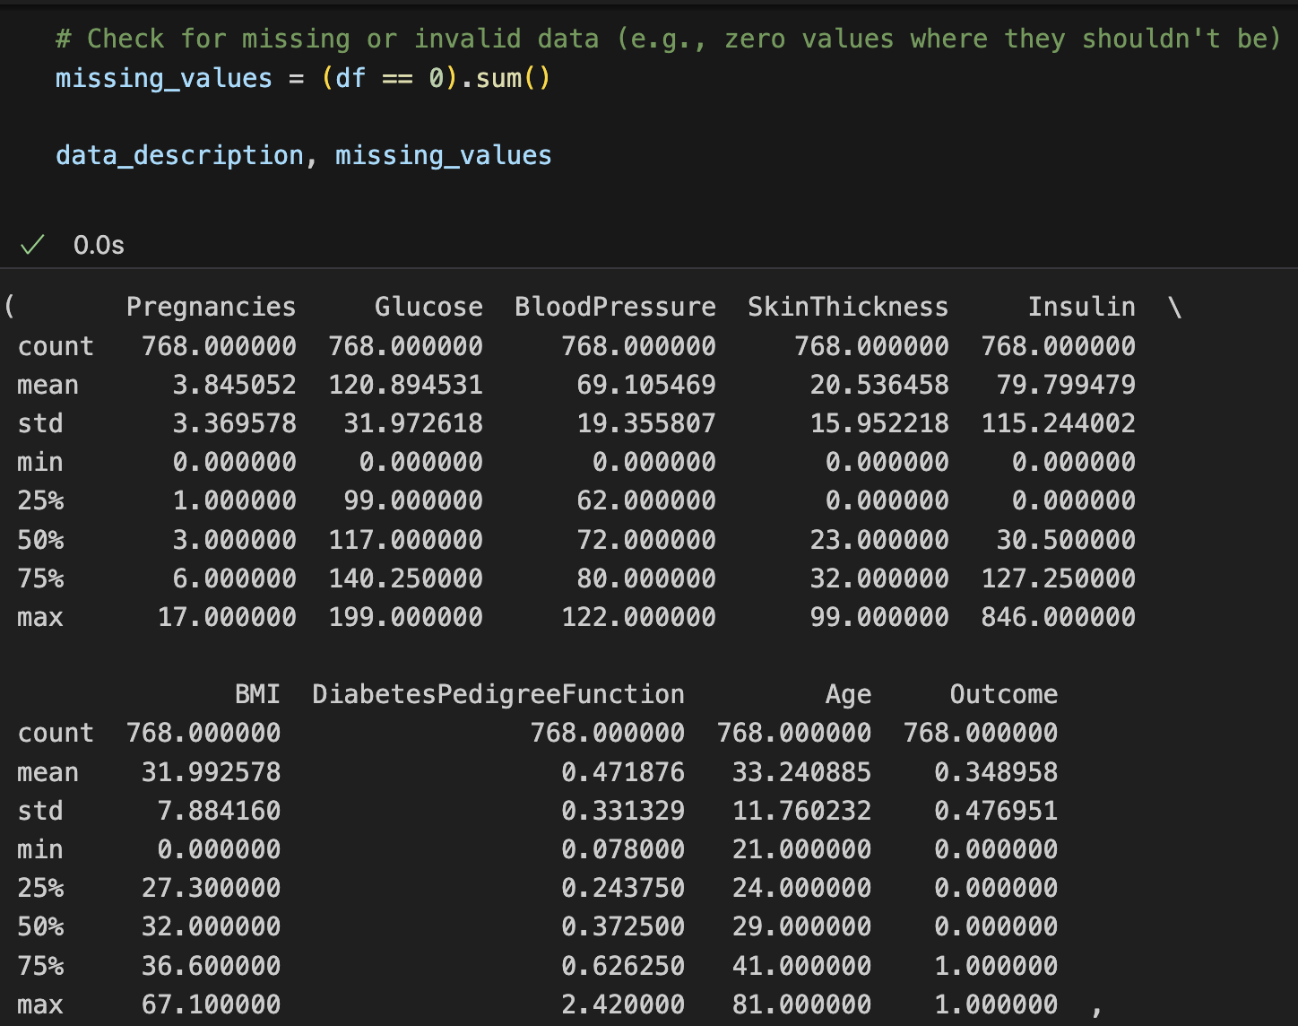
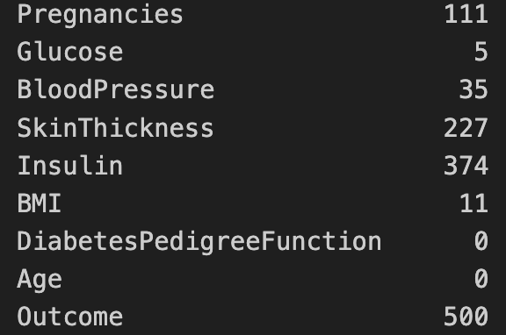
Some 0 values should be considered as missing values or invalid values
Glucose, BloodPressure, SkinThickness, Insulin, and BMI have a minimum value of 0, which is Impossible.
These are the number of 0 values for each feature.
Notes:
The summary statistics provide the following insights:
Some columns like Glucose, BloodPressure, SkinThickness, Insulin, and BMI have a minimum value of 0, which is not practical and indicates that these might be missing or incorrect entries.
The features have different scales, indicating that scaling might be necessary during the data preparation phase.
Next, let’s visualize the distribution of the features and the target variable to gain more insights into the data.

Slide 12
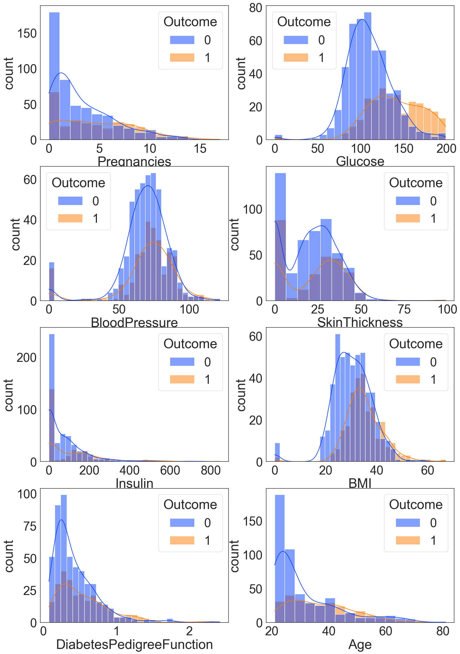
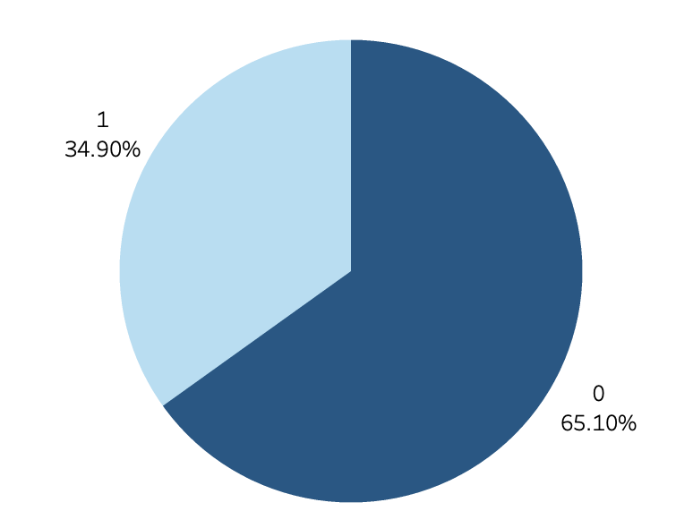
The distribution of each feature
The blue color represents healthy samples, which are the negative cases, while the orange color indicates diabetic samples, which are the positive cases
Approximately 35% of the patients have diabetes (1) and 65% not have diabetes (0).
Notes:
give us several insights:
Pregnancies: Most women in the dataset have less than 5 pregnancies, with the number decreasing as the number of pregnancies increases.
Glucose: There is a spike at 0, which is not a practical value and indicates missing or incorrect entries. The distribution is somewhat right-skewed, with most values centered around 100–140.
BloodPressure: There is a spike at 0, indicating missing or incorrect entries. The distribution is approximately normal, centered around 70.
SkinThickness: A significant number of entries are 0, indicating missing values. The distribution of non-zero values is right-skewed.
Insulin: A large number of entries are 0, indicating missing values. The distribution of non-zero values is highly right-skewed.
BMI: There is a spike at 0, indicating missing or incorrect entries. The distribution of non-zero values is somewhat right-skewed, centered around 30.
DiabetesPedigreeFunction: The distribution is right-skewed, with most values below 1.
Age: The majority of the patients are below 40 years old, with the distribution being right-skewed.
A balanced the dataset can help the model better learn patterns of the minority classes.
In this example, 35% of the patients are diabetic and 65% are healthy. Although the data is not completely balanced, it is relatively not extreme. 35% of the patients with diabetes can still allow the model to learn enough patterns, especially when the amount of data is large.

Slide 13
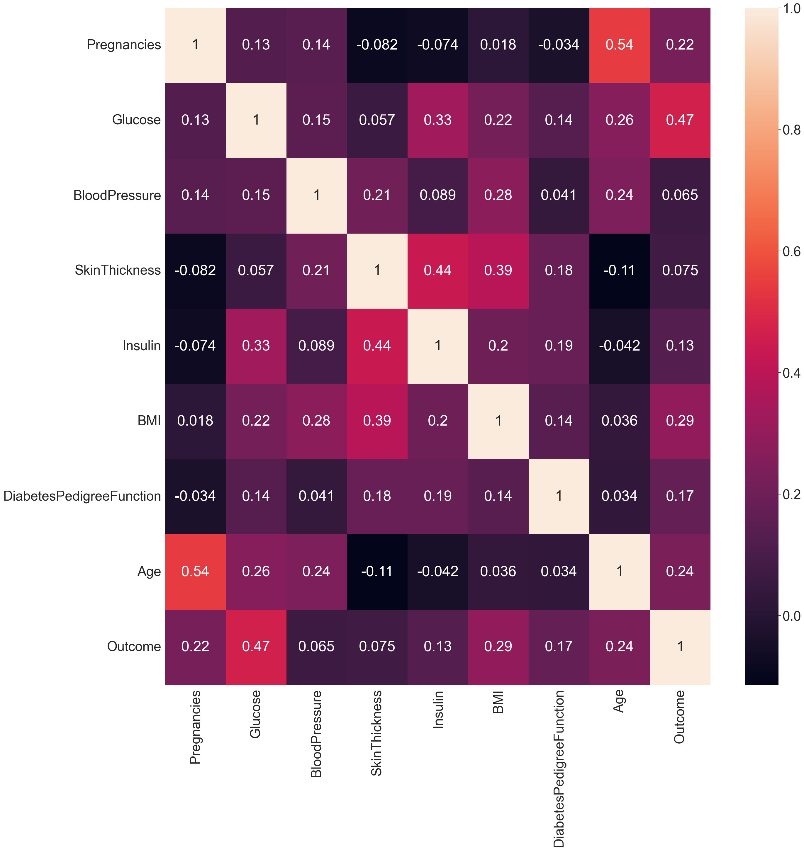
A correlation heat map, the lighter the color, the more relevant it is
The correlation between Outcome and Glucose is high. Glucose is the most important feature.
BMI, Pregnancies, and age can also be important features.
High correlation coefficient between SkinThickness and Insulin. As well as Age and Pregnancies. There may be a multicollinearity problem.

Slide 14
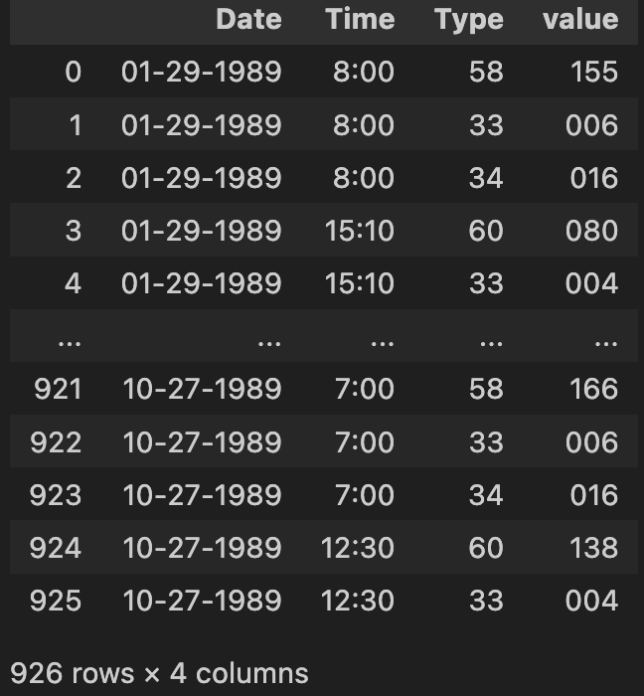
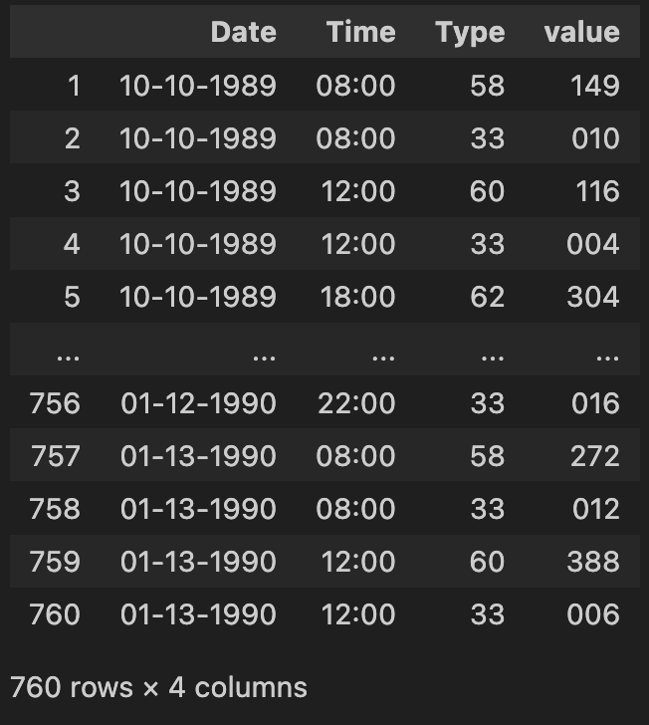
Dataset 2 A record of a diabetic patient’s blood glucose measurements changing over time
33 = Regular insulin dose
34 = NPH insulin dose
35 = UltraLente insulin dose
48 = Unspecified blood glucose measurement
57 = Unspecified blood glucose measurement
58 = Pre-breakfast blood glucose measurement
59 = Post-breakfast blood glucose measurement
60 = Pre-lunch blood glucose measurement
61 = Post-lunch blood glucose measurement
62 = Pre-supper blood glucose measurement
63 = Post-supper blood glucose measurement
64 = Pre-snack blood glucose measurement
65 = Hypoglycemic symptoms
66 = Typical meal ingestion
67 = More-than-usual meal ingestion
68 = Less-than-usual meal ingestion
69 = Typical exercise activity
70 = More-than-usual exercise activity
71 = Less-than-usual exercise activity
72 = Unspecified special event
https://archive.ics.uci.edu/dataset/34/diabetes
Notes:
It contains blood glucose measurements and insulin dosage records from 70 diabetic patients between 1989 and 1999.
Since the original data contains various pieces of information mixed together and difficult to separate, it needs to be processed before data analysis.
These are the records of two patients.

Slide 15
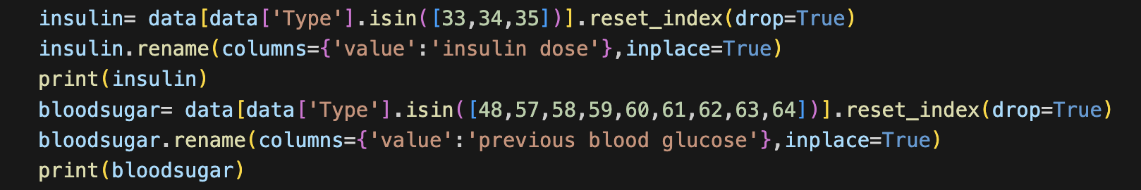
Delete rows containing 66, 67, 68, 69 in the Type column
Extract insulin and blood sugar values ​​and create two tables, based on ‘Type’
Convert object to numeric type and fill na with mean
Then plus the values ​​at the same time point
Notes:
But our input only considers blood sugar value，so the insulin table obtained is only used as a data analysis

Slide 16
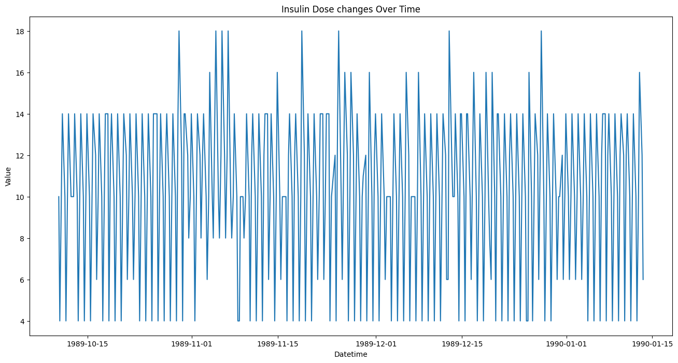
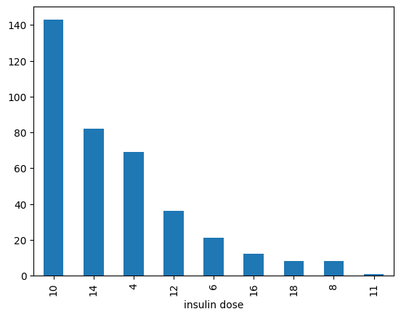
Changes in insulin dose
Number of injections at different doses
Most of the time, 10 units of insulin are injected, followed by 14 units
18 units may also be used on rare occasions
Notes:
It is known that this patient regularly injects insulin

Slide 17
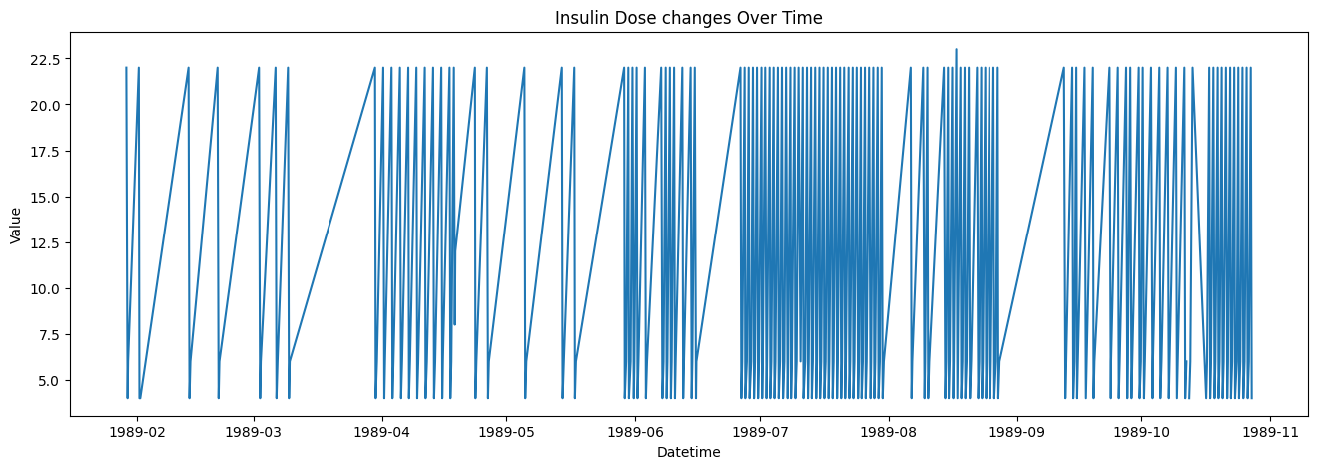
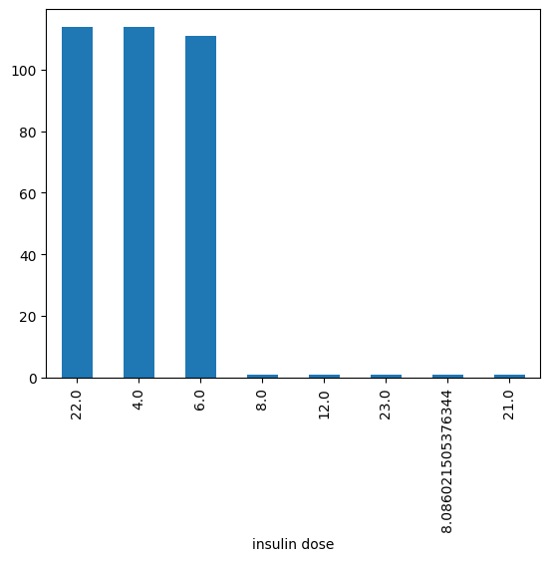
Changes in insulin dose
Number of injections at different doses
They mainly use 22, 4, and 6 units of insulin injection
Notes:
Some gaps can be seen, indicating that the injections were not regular.

Slide 18
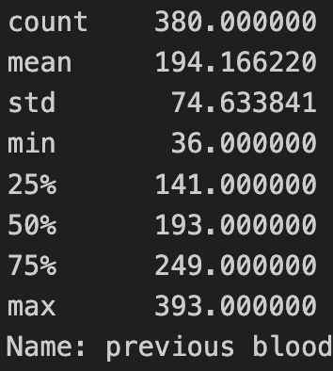
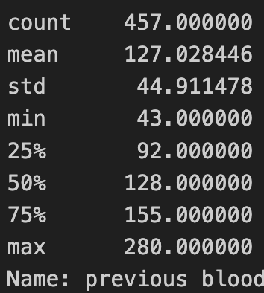
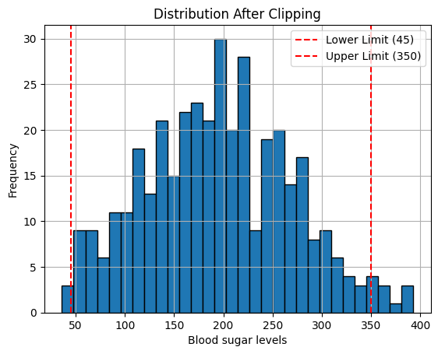
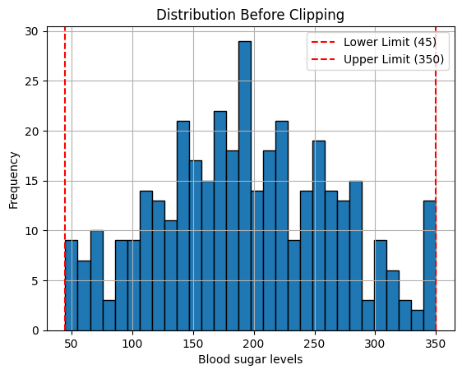
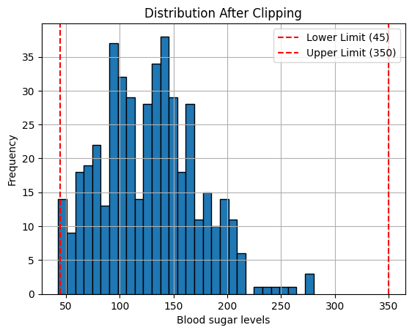
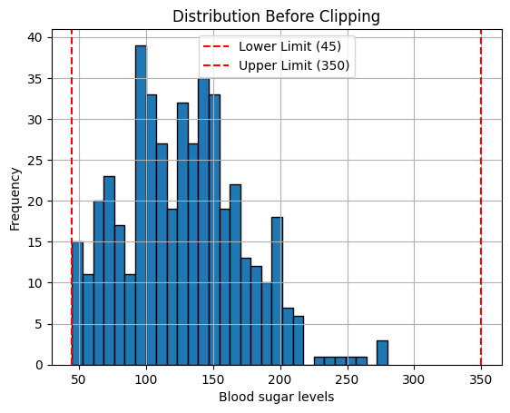
Choose a blood sugar range based on existing knowledge
Restrict the values ​​to a specific range, such as 45 to 350, and use Pandas’ clip method.
This will replace values ​​below the lower limit with the lower limit, and values ​​above the upper limit with the upper limit.
Notes:
Because human blood sugar has a range.

Slide 19
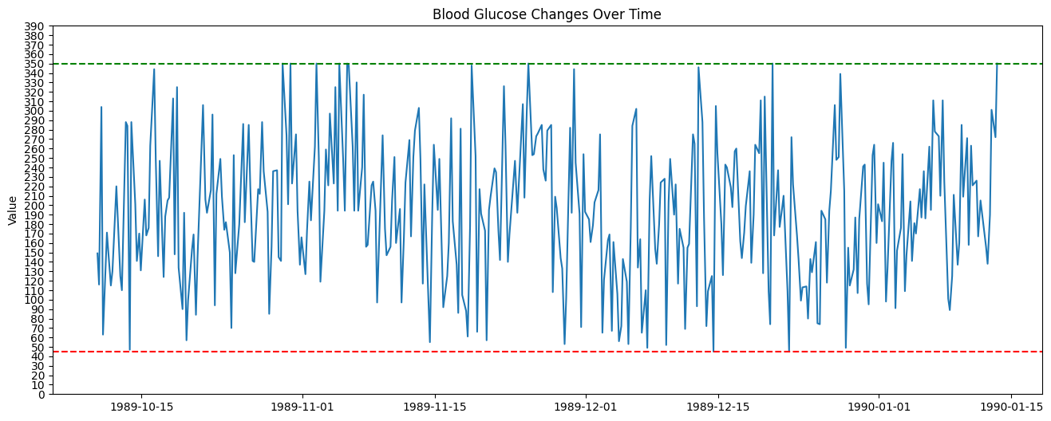
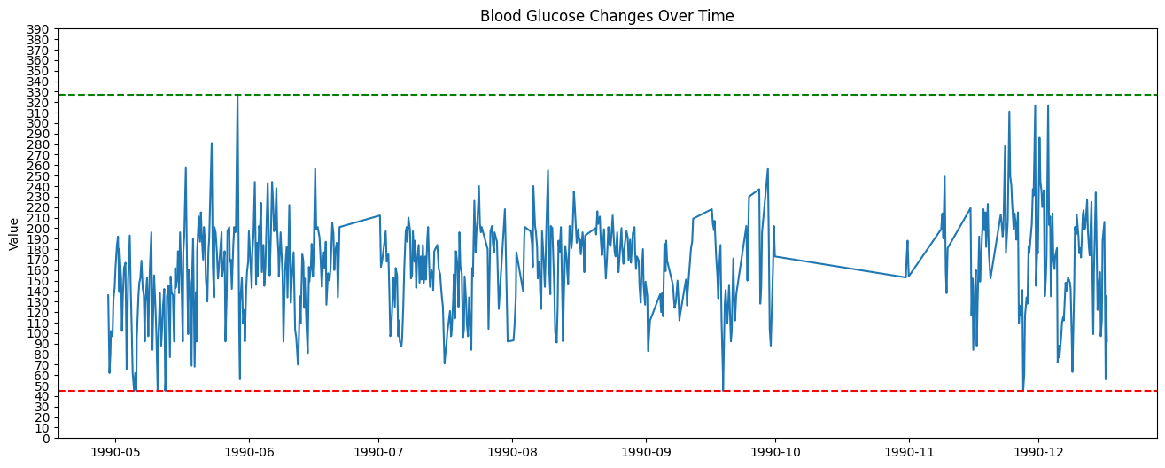
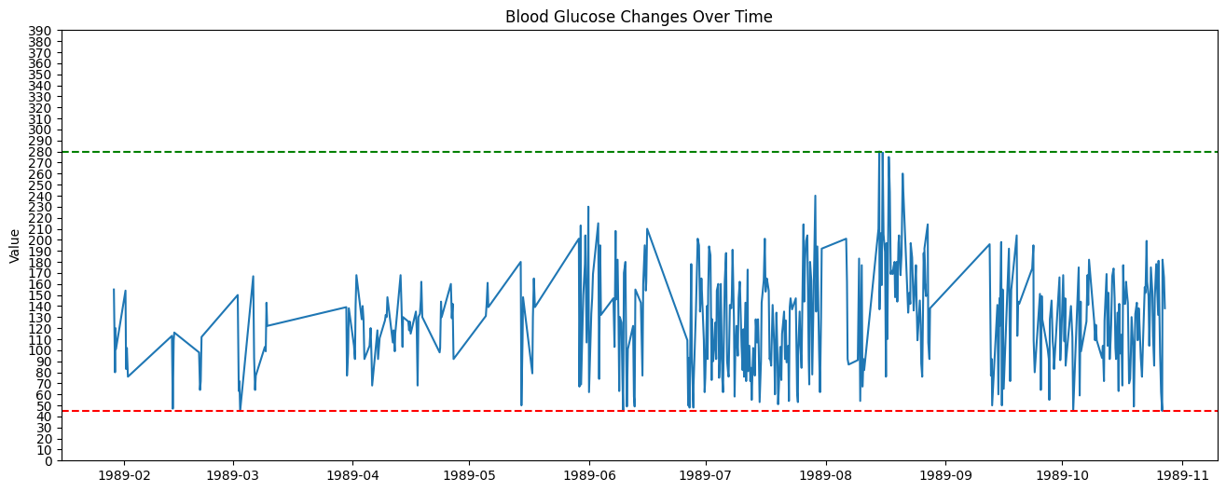
The overall fluctuation trends of blood sugar for some patients from 1989 to1990

Slide 20
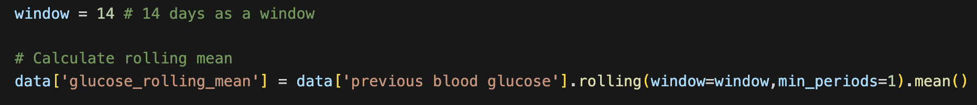
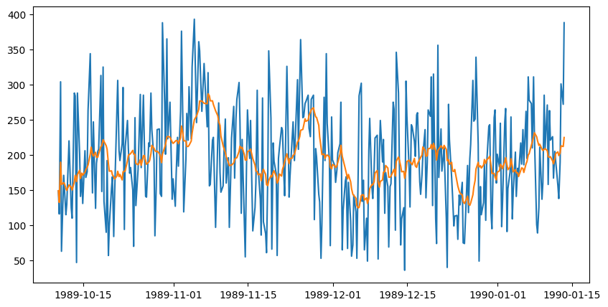
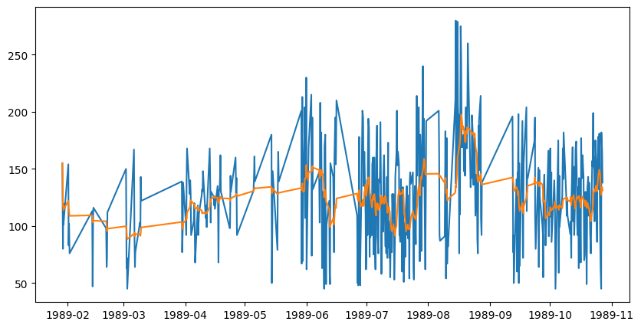
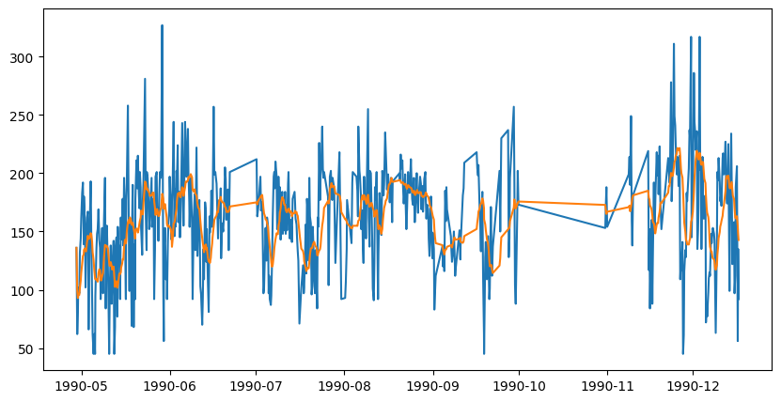
Create a rolling window
This orange line represents the rolling mean
Notes:
While it is possible to see some trends this way, it can be confusing when the data is not of high quality.

Slide 21
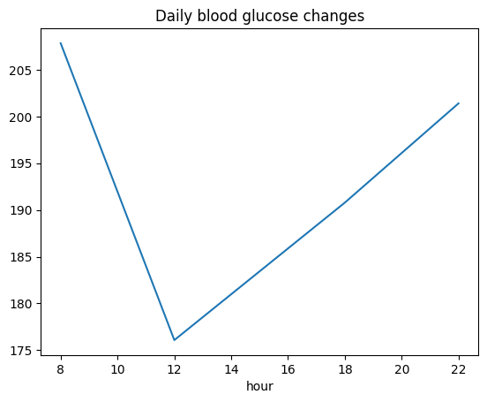
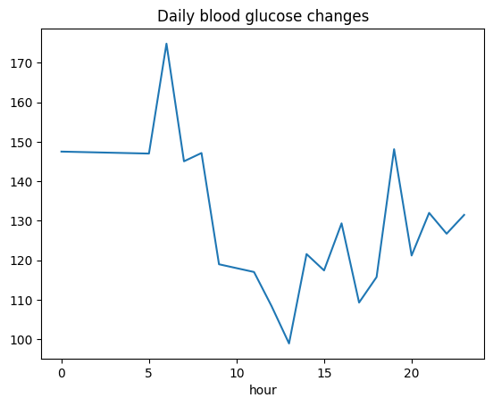
Extract hourly information and calculate hourly mean
Notes:
Group the data by hour and calculate the mean value for each group to obtain. the average variation of the data per hour.

Slide 22
Phase 3 : Data Preparation
Notes:
Handle Missing or Incorrect Entries: Replace the zeros in ‘Glucose’, ‘BloodPressure’, ‘SkinThickness’, ‘Insulin’, and ‘BMI’ with NaN and then impute them.
Feature Scaling: Scale the features to bring them to a similar scale, which helps in improving the model’s performance.
Encoding Categorical Variables: If there are any categorical variables, encode them to numerical format.
Splitting the Data: Split the dataset into training and testing sets to evaluate the model’s performance.

Slide 23
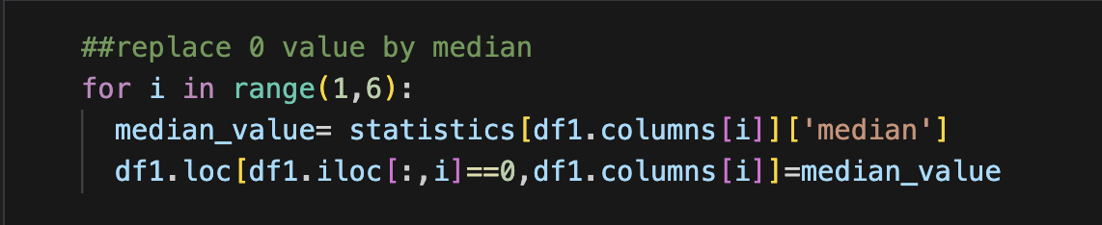
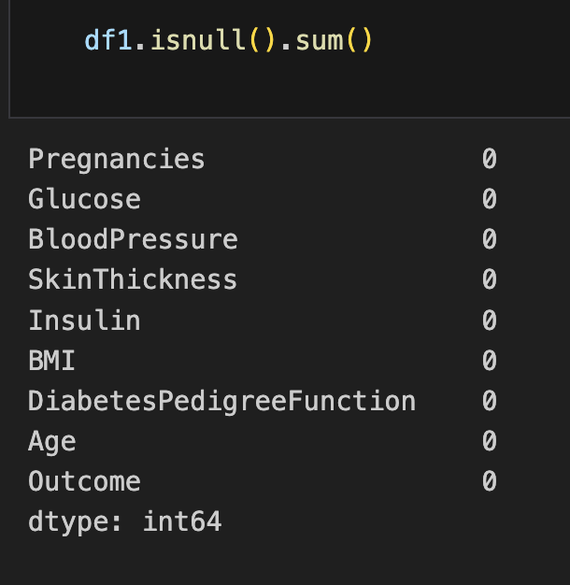
Replace missing values with median
column:Glucose
Mean is: 121.69
Median is: 117.00
column:BloodPressure
Mean is: 72.41
Median is: 72.00
column:SkinThickness
Mean is: 29.15
Median is: 29.00
column:Insulin
Mean is: 155.55
Median is: 125.00
column:BMI
Mean is: 32.46
Median is: 32.30
Notes:
There are various strategies for imputation, such as replacing with the mean, median, or mode of the column, or using more sophisticated methods like model-based imputation. For this exercise, we’ll use the median of the column to replace the missing values, as the median is less sensitive to outliers compared to the mean.

Slide 24
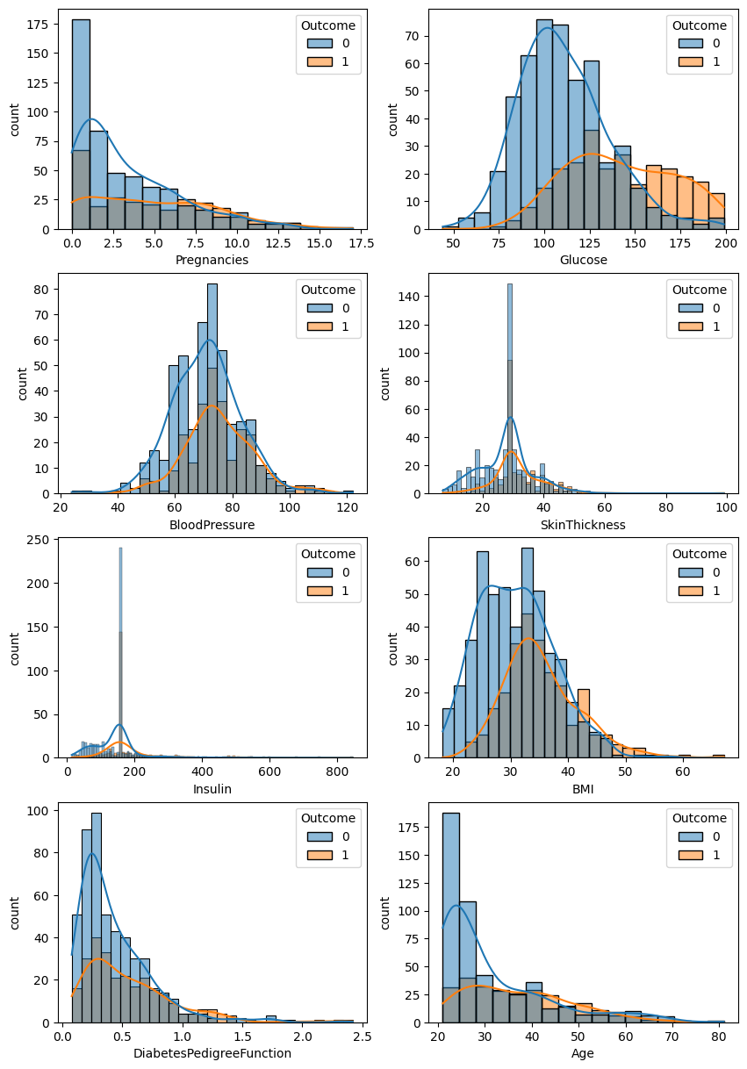
The distribution of each feature, after handling missing values
Notes:
我们可以看见在。。之后，the 0 in some features have disappeared，and The d。。。。almost unchanged，

Slide 25
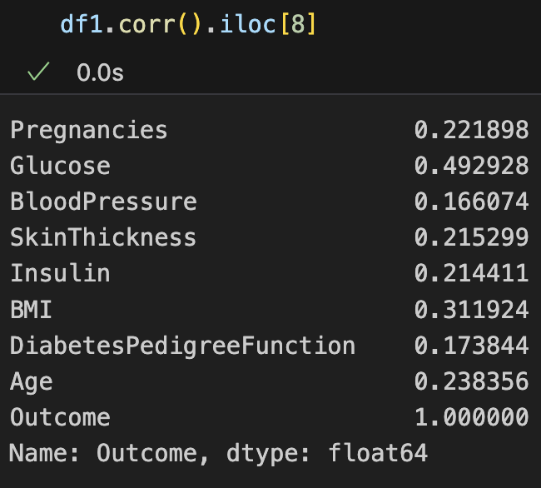
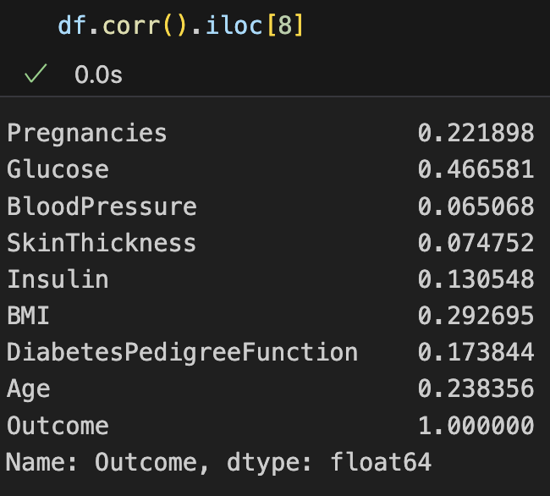
Compare correlation coefficients
Notes:
这意味着，我们的缺失值Handing 策略是合理的

Slide 26
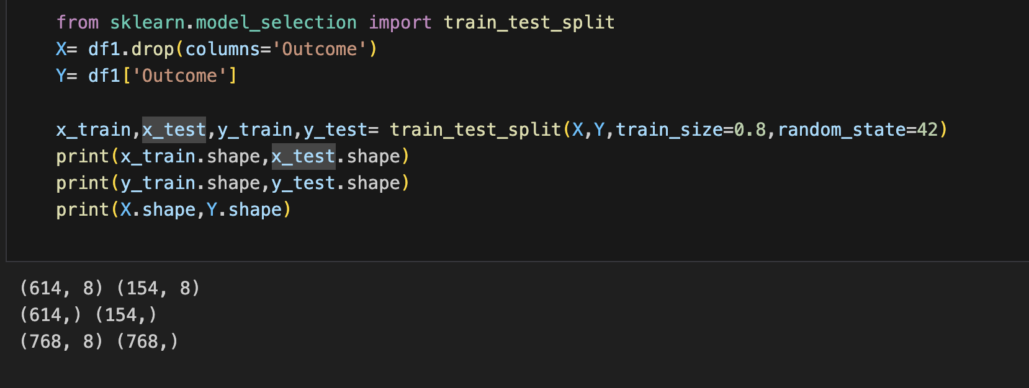
Split dataset and Feature Scaling
The dataset has been successfully split into training and testing sets. The training set contains 614 samples, and the testing set contains 154 samples. Both sets have 8 features

Slide 27
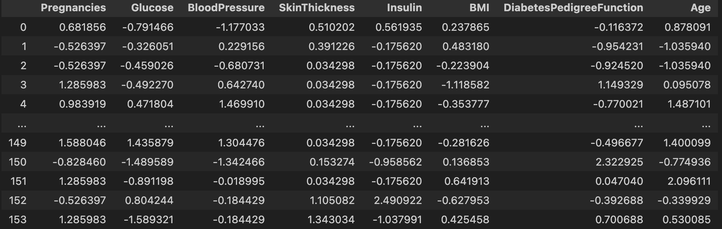
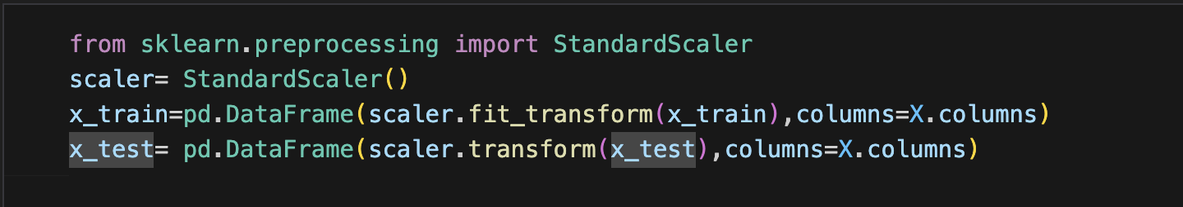
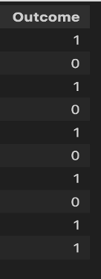
The features have been successfully scaled using the StandardScaler. The scaled features are now represented by X_train, X_test and have a mean of 0 and a standard deviation of 1.
Next, we will check if there is a need for feature engineering or encoding of categorical variables. In this dataset, all the features are numeric, and there are no categorical variables to encode. Additionally, we do not have specific domain knowledge to create new features at this point, so we will not perform feature engineering.

Slide 28
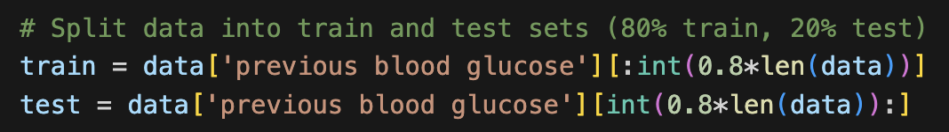
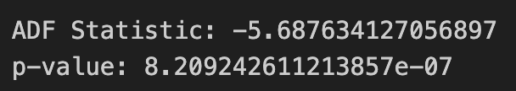
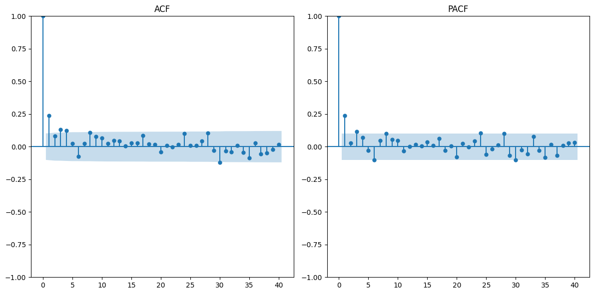
Data set 2; For ARIMA :
ARIMA models generally do not require normalization or scaling of the data , the algorithm is based on differencing
Check stability
ADF and P-value: Reject the null hypothesis
Determine ARIMA model parameters (p, d, q)
ACF(Autocorrelation Function)：p
PACF(Partial Autocorrelation Function)：q
Differencing：d
Notes:
ARIMA models generally do not require normalization or scaling of the data because their algorithm is based on differencing and trend modeling of the time series rather than on distance or gradient optimization (as machine learning models do).
差分If I use differencing The result will be a new time series that reflects the change at each time point relative to the previous time point.
Acf,dacf: Correlation of a time series with itself at different time lags.

Slide 29
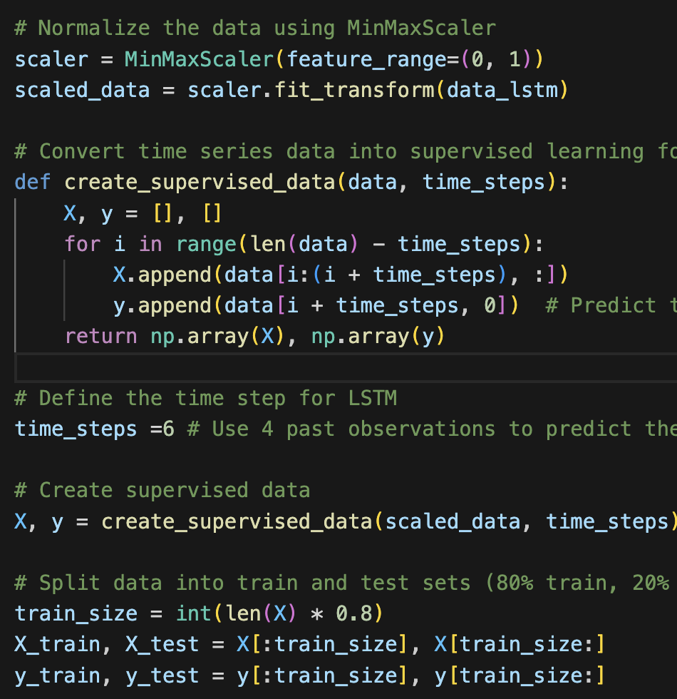
For LStm ：
Normalization： scales the data to the range [0, 1]
Reshape the time series data into a form that can be used by the LSTM as input, i.e., use past time windows to predict future values.
The data is divided into a training set and a test set
The LSTM model requires three-dimensional input data in the format of (number of samples, time steps, number of features).
Notes:
time_steps defines the time window size. For example, time_steps=6 means that 6 consecutive time points are used as input each time.
X is a 3D array with shape (number of samples, time steps, number of features), and each group of time steps corresponds to a training sample.
y is a 1D array that stores the target value after each time window (here, the blood sugar value in column 0).
The LSTM model requires three-dimensional input data in the format of (number of samples, time steps, number of features).
Each sample consists of time_steps in the past.

Slide 30
Phase 4: Modeling
Data Set 1:
Logistic Regression
Random Forest
K-Nearest Neighbors
Support Vector Machine
Decision Tree
Linear Regression
Multi-layer Perception
Data Set 2:
ARIMA
LSTM
Notes:
We can implement the modeling phase by selecting a few popular classification algorithms, training them on the dataset, and comparing their performance

Slide 31
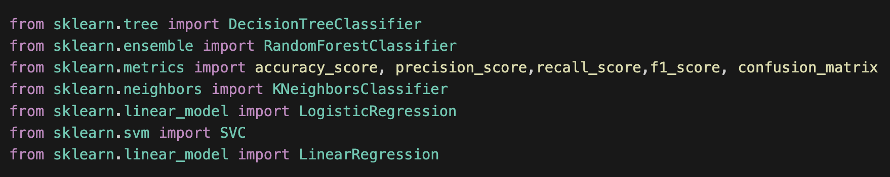
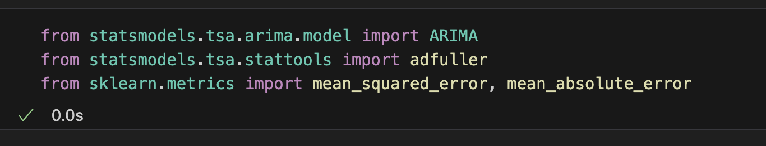
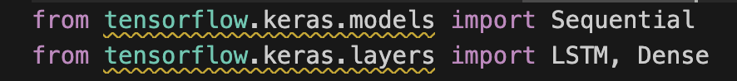
For each model, we will train it using the training data, evaluate its performance on the testing data using various metrics such as accuracy, precision, recall, F1-score, and specificity, and compare the results.
Based on the evaluation, select the optimal model.
Notes:
Select Models: Select a few popular classification models for comparison.
Train Models: Train each selected model on the training dataset.
Evaluate Models: for time series model: M-S-E and mean_absolute_error,and loss function

Slide 32
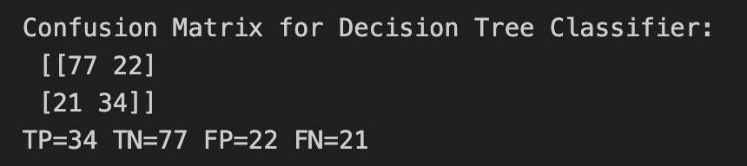
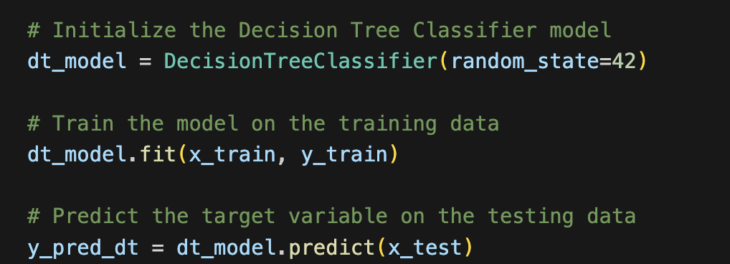
Decision Tree Classifier (DT)
Recall: Among all samples that actually have diabetes, the model correctly identified 61.82% of diabetic patients.
Precision: 60.71% of the samples predicted by the model to be diabetic are correct.
It is insufficient in identifying positive samples (diabetic patients), especially the relatively high number of FP and FN. False positive and false negative predictions may mislead patients or delay treatment in practical applications.

Slide 33
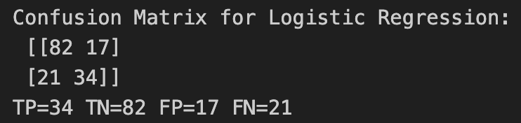
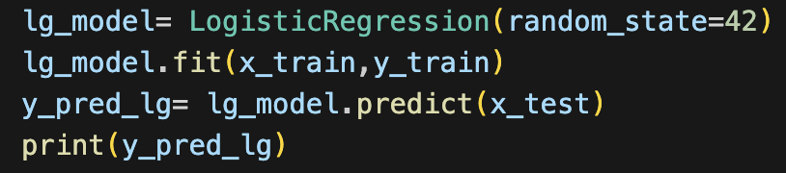

Logistic Regression
Recall&Precision: About 61.8% of the positive samples were correctly classified, and about 66% of them were accurate. Same recall as Decision Tree.
Logistic regression outperforms the decision tree classifier in precision, specificity, and overall accuracy, which means it performs better on negative samples and has a higher accuracy in predicting positive samples.
Recall still not very high. Good specificity(TNR)

Slide 34


Random Forest Classifier
Recall,TP : Slightly better than decision trees and logistic regression, indicating that random forests have a slight advantage in identifying positive samples. Not enough.
High FP=21,FN=20, so, precision 62.5%; 62.5% samples that predicted as positive are actually positive. Some healthy people are misdiagnosed.

Slide 35


K-Nearest Neighbors (KNN)
The highest recall, the lowest precision
Lower FN, higher FP
Although the model can find 63% of the positives, it has many errors, and less than 60% of the samples predicted as positive are correct.

Slide 36


Support Vector Machine (SVM)
On the contrary: Higher precision, the lowest recall; higher FN, lower FP.
Miss many actual cases. Still not effective.
Highest TN=83, specificity(83.8%)Good ability to predict true negative samples.

Slide 37


Linear regression
Set threshold = 0.5
Best precision(70%), specificity(85.8%), f1(66%), accuracy(77%), but recall still not high(61.8%)
FN =21 is a little high, the lowest FP=14
Precision is good, meaning there are few errors in predicting positives. However, there is still room for improvement in identifying true positive samples (recall).

Slide 38

Multi-layer perception
Can correctly identify 67.27% of the positive samples. (Highest), About 63% of the positives are true.
A relatively stable performance in detecting diabetic patients.
F1(64%): The combination of the precision and recall. F1 score is the second highest. performance is more balanced.

Slide 39


Models' comparison
Need high specificity(low FP)(Prioritized)
Diabetes screening is often a tool for early detection. In this case, the model’s specificity is often more important
If the False Positive is high, it means that the model will misdiagnose many healthy people as diabetic, which may lead to unnecessary further treatment or lifestyle changes, as well as increase the psychological burden of the patient.
linear regression is recommended. Can reduce false positives for healthy individuals. Also, it have the highest specificity.
Notes:
The Receiver Operating Characteristic (ROC) curve and the Area Under the Curve (AUC) are present model’s performance. The ROC curve plots the True Positive Rate (sensitivity) against the False Positive Rate (1-specificity) at various threshold levels, and the AUC measures the area under the ROC curve. A model with an AUC of 1.0 is perfect, while a model with an AUC of 0.5 is no better than random guessing.

Slide 40
Models' comparison
Recall also needs to be considered:
So, MLP is recommended. It can identify more positive cases. Although linear regression has very high specificity, its recall is low, which means it misses many patients.
Balanced performance: MLP. Focus on both false positive and false negative risks.
It has the second highest F1- score
Notes:
We cannot simply tell patients that there healthy just to avoid giving them psychological(赛）stress
So need to see f1
So, in conclusion, it is the most balanced model among all of them

Slide 41
In this project, the initial goal of the deployment is to integrate the Linear Regression model into the existing system of the medical situation in order predict the risk of diabetes in patients. （specificity ：88，recall：61，precision：70, f1-score: 66） As the amount of data increases, it is planned to introduce MLP (Multilayer Perceptron) models to further improve prediction performance. （specificity ：77，recall：67，precision：62, f1-score:65）

Slide 42
Part two
Use historical blood sugar records to predict blood sugar changes over a period of time
Using ARIMA Model and LSTM model

Slide 43

auto_arima function
Find the minimum AIC
The best model is (1,1,3)

Slide 44

Use training data to predict future trends
The length of the forecasting period is equal to the length of the test data, so the predicted performance can be compared with the original data
Notes:
Unfortunately, the prediction result of the ARIMA model is a straight line, and it cannot be predicted well on the training set.

Slide 45


LSTM prediction results on the testing set
It can be clearly seen that the LSTM model can better find the change pattern of time series data, and thus have better prediction performance than ARIMA model
Notes:
the prediction line has more details than the previous ARIMA model, and the prediction line is closer to the original data,

Slide 46


The Loss function is converging
Notes:
肯verG紧

Slide 47

Predict the next 7 days
Use the last timestep window as initial data for future predictions
Use the model to make predictions for the last timestep window
Then use the predicted data as input and loop 7 times
Notes:
Because the previous forecast data is still in the historical data, there is no new data

Slide 48
Phase 5: Deployment
In the first step, we need to export model to a file, which can then be deployed to a production environment
A file format such as a Pickle file in Python. This file contains all the information required to reconstruct and use the model.
The exported model file is then deployed to a production environment, where it can be loaded and used to make predictions on new, unseen data.

Slide 49
Deployment strategy
For Problem 1:
Initial deployment model: linear regression model
Future Deployment model : MLP Model
For Problem 2：
Deployment model : LSTM

Slide 50
For problem 1
Data collection: During the initial deployment, more patient data is collected on an ongoing basis to ensure data quality and diversity. Model training and validation: When the amount of data increases significantly, the MLP model is trained and its performance is evaluated through metrics such as cross-validation and AUC. Monitoring and Maintenance: Once deployed, continuously monitor the model’s performance and update or retrain it as needed.
Smooth transition: After confirming that the MLP model is superior to the linear regression model, gradually replace the existing linear regression model.

Slide 51


Feature Importance Analysis:
Feature importance analysis shed light on the factors driving accurate predictions. Notably, features such as Glucose, BMI, DiabetesPedigreeFunction, and Age played pivotal roles in determining whether a patient is likely to have diabetes. Understanding the significance of these features can aid healthcare professionals in making informed decisions.

Slide 52
For Problem 2
Model monitoring and maintenance
The deployed model needs to be continuously monitored and maintained to ensure its performance and reliability:
Model performance monitoring:
Regularly evaluate the prediction accuracy of the model on new data.
Monitor changes in the input data distribution to detect potential data drift issues.
Model update and retraining:
Regularly collect new blood glucose data and add it to the training set to update the model.

Slide 53
Integration and interface development:
Develop a front-end application or mobile application for users to input historical blood sugar data or personal physiological sign data and view the results.
Integrate API so that the front-end can call the model in real time to generate trend predictions or diabetes risks.

Slide 54
Conclusion
In this comprehensive study, we applied the Cross-Industry Standard Process for Data Mining (CRISP-DM) methodology to develop a predictive model for diabetes diagnosis. Through a systematic approach, we gained valuable insights into the data, trained and evaluated multiple classification models and prediction model, and selected the most effective model for the task.

